Slide 1
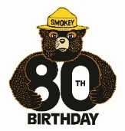
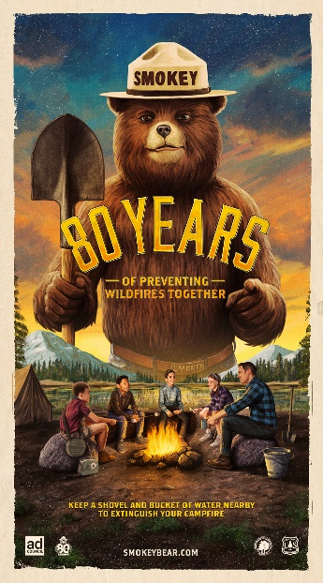
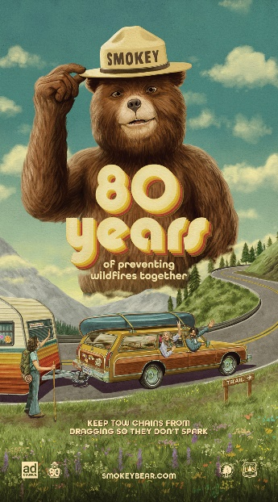
SMOKEY BEAR FACT SHEET
WILDFIRE PREVENTION CAMPAIGN
Smokey Turns 80: 2024 marks the 80th birthday of America's favorite bear. Since 1944, Smokey Bear has inspired Americans to protect our forests from unwanted, human-caused wildfires through simple fire safety tips and his iconic tagline, "Only You Can Prevent Wildfires." As America’s longest-running PSA campaign, for over 8 decades Smokey has become a cultural icon and an important pillar in protecting our nation's wildlands. This year, we will celebrate his legacy, impact, and nostalgia through new PSAs, social media and influencer extensions, PR moments, and significant industry partnerships.
Campaign Objective: Prevent unwanted, human-caused wildfires by encouraging personal responsibility and imparting knowledge of individual actions people can take to help prevent fire starts.
Target Audiences:
Outdoor Enthusiasts (primarily 18-34)
Wildland-Urban Interface Residents (primarily 25-54)
Message: Only you can prevent wildfires.
Call to Action: For 80 years, Smokey Bear has lived within us all. Learn more at SmokeyBear.com.
Campaign Social Media Presence: Facebook, Instagram, Twitter and YouTube
History of Smokey Bear: click here to learn more.

